Slide 1

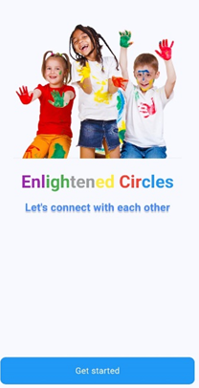
EnlightenedCircles
Presenting :Or Meira Balmas Ofir Galai
Supervisor: Dr. Anat Dahan
24-1-D-22 Software Engineering Department
Braude College
Capstone Project Phase B
“UNITED AS A COMMUNITY, STRONGER AS A FAMILY...”

Slide 2

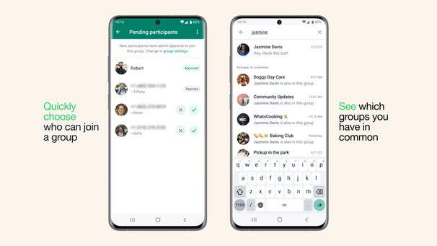
Introduction-background
The problem: Today, there are families across the country coping with one or more children constant attention to the child, necessary physical presence. these parents often struggle to find leisure or personal time for themselves due to the demands and needs of their child.
So, what are the existing solutions today? Social Media Groups: There are groups on different social media platforms like Facebook and WhatsApp. Support Associations: There are support associations specifically for families with children with special needs, such as “Wings of Krembo” and “Aleh.”

Slide 3


Our Solution
A socisl media platform that will help and supports this families.
The network will include location-based and other features groups where users can share their needs and receive relevant responses. Our solution aims to provide a more focused and personalized approach to support families with children with special needs, allowing them to connect with others who truly understand their situation and receive timely assistance.

Slide 4
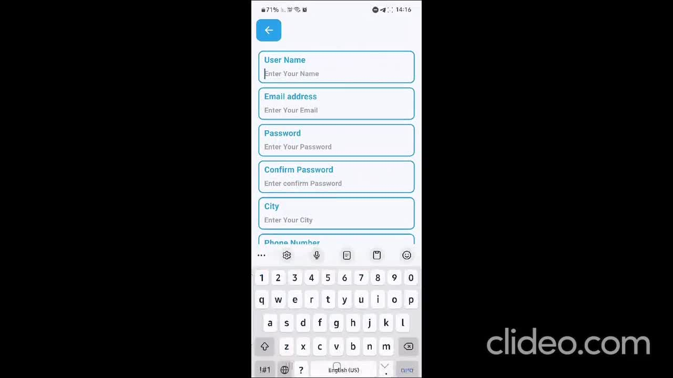
Our Video showing the application

Slide 5
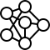
The algorithm behind the app
In our project, we implemented the Louvain algorithm to detect communities based on a user graph, where each connection between users is weighted according to various criteria.
We created a graph where each user is represented as a node, and the connections between users are represented by weights calculated based on geographical proximity, shared hobbies, age, pets, and disabilities. Users who share more of these characteristics are given stronger connections in the graph.

Slide 6
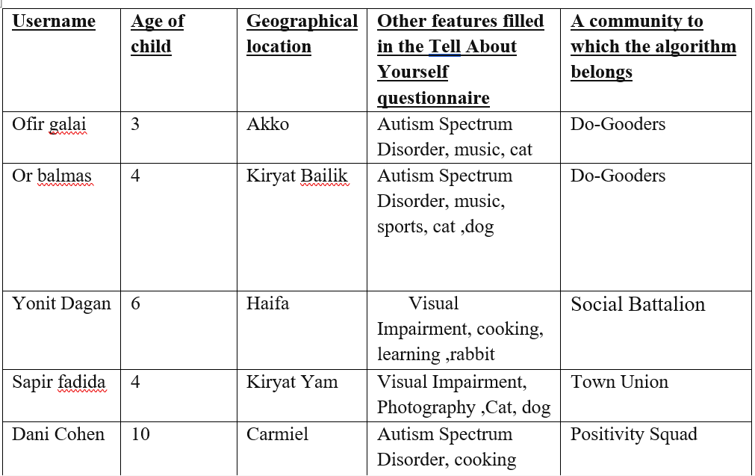
App Testing- Simulation Results
To test our community-building algorithm, we added several users to the application. By completing the questionnaires, different and diverse communities were suggested to each user according to their preferred match
These are some of profiles of the features of all the users we tested in the simulation- in total we tested 15 users:

Slide 7
App Testing- Simulation Results
The Louvain algorithm successfully divided the 15 users into distinct communities based on multiple criteria, including geographical location, shared hobbies, disabilities, and the age of the user's child.
1. Shared Features:
o Hobbies and Disabilities: Users with similar hobbies and disabilities were often placed in the same community. For example, those with visual impairments and interests like cooking or photography were grouped together in communities such as Town Union and Social Battalion.
o Geographical Proximity: Users from similar locations, like Akko, Carmiel, and Haifa, were sometimes grouped together. However, geographical proximity was not the dominant factor in community formation.

Slide 8
Analysis of the simulation results
The Louvain algorithm successfully divided the 15 users into distinct communities based on multiple criteria, including geographical location, shared hobbies, disabilities, and the age of the user's child.
1. Shared Features:
o Hobbies and Disabilities: Users with similar hobbies and disabilities were often placed in the same community. For example, those with visual impairments and interests like cooking or photography were grouped together in communities such as Town Union and Social Battalion.
o Geographical Proximity: Users from similar locations, like Akko, Carmiel, and Haifa, were sometimes grouped together. However, geographical proximity was not the dominant factor in community formation.

Slide 9
Analysis of the simulation results
3. Diversity in Communities: Some communities, such as Social Circle, had a higher concentration of users with specific shared traits like gardening and cerebral palsy, while others like Do-Gooders displayed more diversity in user characteristics, such as different disabilities or a wider range of hobbies.
4. Focus on Commonalities: The algorithm seemed to prioritize shared hobbies and disabilities over geographic location and child’s age when determining community membership. For example, users with similar disabilities like autism spectrum disorder were grouped together even if they were from different locations.

Slide 10
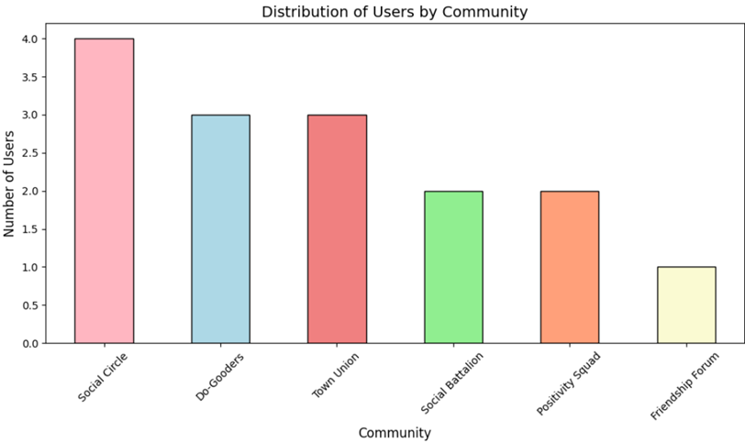
Analysis of the simulation results
Overall, the algorithm effectively created personalized communities based on shared interests and traits, though certain factors like geography played a lesser role compared to shared hobbies and disabilities. It is important to say that sometimes the algorithm offered users several options for a community that could suit them.

Slide 11

Project evaluation- user experience
In our project, we chose to utilize the System Usability Scale (SUS) questionnaire to gather feedback on our application. The SUS is a widely recognized tool for assessing the usability of a system, application, or product. It provides a quick and reliable method for evaluating the user experience, which is crucial for ensuring that our app meets the needs and expectations of its users.

Slide 12
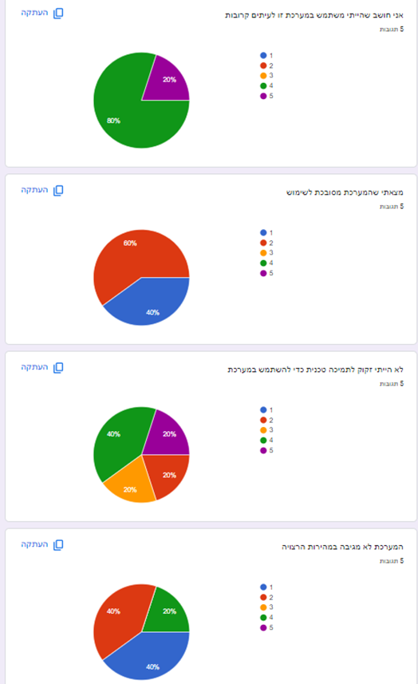
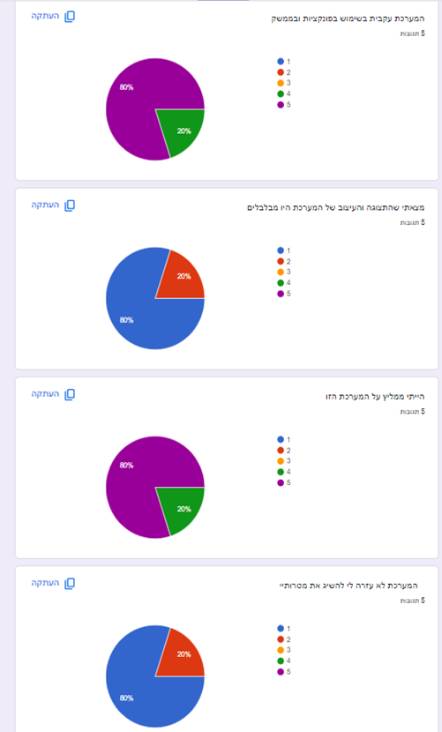
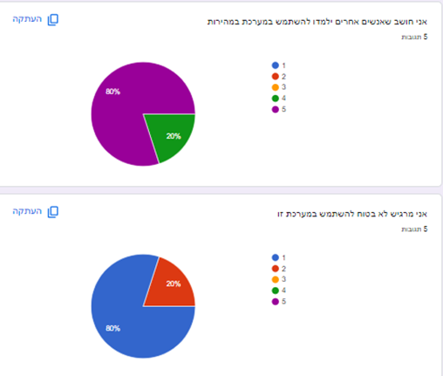
S.U.S Results
The average score of the
questionnaire was 87.5

Slide 13
Project Challenges
1. Hardware Issues: Using Android Studio in combination with VS Code requires a lot of system resources, including RAM and processing, which can cause computers with less powerful hardware to run slowly .
2.Engineering Challenges: We encountered difficulties with our algorithm for community development. Implementing it proved challenging, so we decided to simplify the algorithm by reducing its complexity.
3. User Experience: Designing an intuitive and user-friendly interface requires careful consideration and may involve multiple iterations based on user feedback. This includes adjusting visual elements like colors and font sizes to improve accessibility and usability. We design an intuitive and user-friendly interface requires careful consideration and may involve multiple iterations based on user feedback.

Slide 14
Implementation of technologies
In this product we will use the Android studio for the application. Also, we will use the Flutter App and the Firebase.
1.Flutter App: Flutter is a software development kit for open-source user interfaces created by Google. It is used to develop applications for mobile devices, web, and desktop from a single source code. It allows for the development of beautiful user interfaces, fast performance, and efficient development workflows.
2. Firebase: Firebase is a comprehensive platform developed by Google for the development of mobile and web applications. It offers a comprehensive set of tools and services for application development, improving application quality, and promoting its growth. It is widely used by developers and businesses due to its ease of use, scalability, and integration with other Google services.

Slide 15
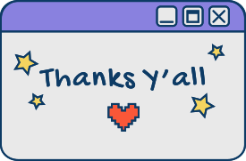
Thanks for listening!

